Slide 1
NM OSAP Recipients Meeting
August 20, 2019
NM State Evaluation Team
Dave Currey, Ph.D. dcurrey@pire.org
Marissa Elias, MPH - melias@pire.org
Liz Lilliott, Ph.D. – Lilliott@pire.org
Christina Lopez-Gutierrez - clopez@pire.org
Ashley Simons-Rudolph, Ph.D. asimons-rudolph@pire.org
Martha Waller, Ph.D. – mwaller@pire.org
Kim Zamarin, MPH - kzamarin@pire.org
Lei Zhang, Ph.D. - lzhang@pire.org
Presentation

Slide 3
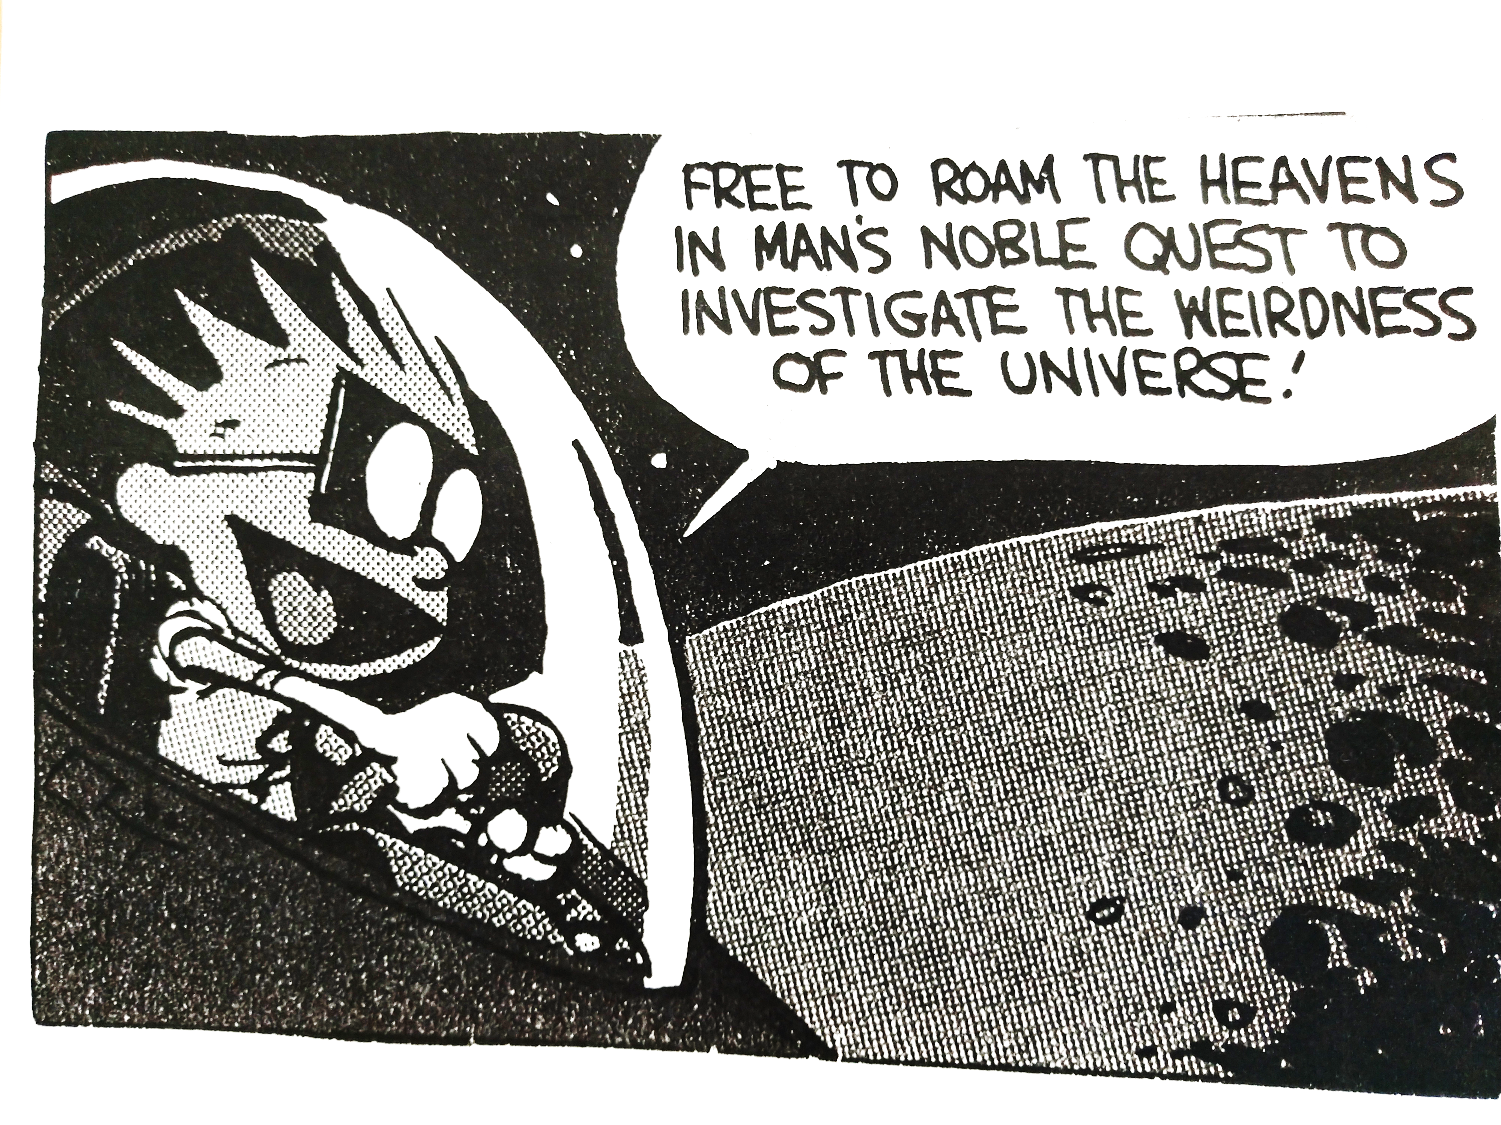

Slide 4
Take home messages AcrosS DataSets
This presentation highlights some noteworthy findings: Full set of finding slides distributed separately
Relatively stable drinking past 6 years in adults
In MS, alcohol, tobacco, and marijuana use is up, in HS all are down/same except sharp spike in e-cig
Use of painkillers to get high are down for MS & HS
Generally high perception of risk to get caught
Many adult current opioid users use them to get high; especially men
Hispanics and Native Americans most likely to report locking up meds

Slide 5
Fiscal Year 2019: New Mexico Community Survey Data

Slide 6
Convenience Sample Demographics: Gender and Race/Ethnicity
Demographic | N | Actual % | Census %
Male | 4215 | 35.8 | 49.1
Female | 7575 | 64.3 | 50.9
Non-Hispanic White | 4223 | 34.9 | 41.0
Hispanic | 5342 | 44.2 | 45.8
Native American | 1868 | 15.5 | 8.4
Other | 656 | 5.4 | 4.8

Slide 7
Alcohol use by Sub-Groups
Gender
Race/Ethnicity
More males than females
use alcohol
binge drink
drink & drive
purchased for minor in last 30 days
Most alcohol use by Whites, then Hispanic, “other,” and Native American
Hispanic had greatest rates of binge drinking, followed by Native Americans, Whites, and others

Slide 8
Past 6 year alcohol Trends

Slide 9
Past 6 year alcohol Trends

Slide 10
Perception of RIsk
Indicators from NMCS 2019 | 2019 State-level Weighted %
Likelihood of police breaking up parties where teens are drinking: Very or somewhat Likely | 62.3
Likelihood of police arresting an adult for giving alcohol to someone under 21: Very or somewhat Likely | 66.6
Likelihood of being stopped by police if driving after drinking too much: Very or somewhat Likely | 72.6

Slide 11
Retail Access
Indicator from NMCS 2019 | 2019 State-level Weighted %
Bought alcohol at a store, a restaurant or public place(among youth ages 18-20 who used alcohol last 30 days) | 6.3

Slide 12
Social Access
Indicator from NMCS 2019 | 2019 State-level Weighted %
Access to alcohol at a party (among youth ages 18-20 who used alcohol last 30 days) | 22.3
Access to alcohol at a college party (among youth ages 18-20 who used alcohol last 30 days) | 27.0
Parents or guardians provided alcohol (among youth ages 18-20 who used alcohol last 30 days) | 7.7
Took alcohol from home or someone else's home (among youth ages 18-20 who used alcohol last 30 days) | 7.4
Last year purchased or provided alcohol to underage youth | 2.4

Slide 13
Community Concern /Awareness
Indicator from NMCS 2019 | 2019 State-level Weighted %
Problems due to drinking hurt my community financially : Agree or strongly agree | 67.2

Slide 14
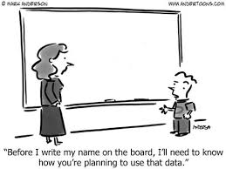

Slide 15
Prescription Painkiller use by race/ethnicity
Gender
Race/Ethnicity
Slightly more women than men report use over the last 30 days and the last year
Women more likely to share medications than men
but…. Women are more likely to report harm and to safely store medication
Men are slightly more likely to report painkiller use to get high
Whites more likely to report receiving scripts and using painkillers
“Other” racial category most likely to use painkillers to get high, followed by a tie between Hispanic and Whites
Whites report a greater perception of risk, while being least likely to lock away meds. Hispanics and Native Americans are most likely to lock up meds.

Slide 16
NMCS Rx Opioid measures: Trends over the past 6 years

Slide 17
Rx Painkillers: Reasons for use (N=1,222)

Slide 18
Rx Painkillers: Access (n=1,222)

Slide 19
Fiscal Year 2019: Annual Strategies for Success Preliminary Results

Slide 20
ASFS Sample
Middle School (N=4710)
6th grade-1336
7th grade-1642
8th grade-1675
9th grade-12
6.1% housing unstable
High School (N=4354)
8th grade-13
9th grade-1517
10th grade-1135
11th grade-994
12th grade-677
3.7 housing unstable

Slide 21
Drug use trends in Middle School
Rising Use
Falling Use
Current Alcohol
Current and Lifetime Marijuana
Current Cigarettes and Chewing Tobacco
Lifetime Alcohol
Current Binge Drinking
Current Painkiller to get High (down 2.5 percentage pts!)

Slide 22
Drug use trends in high School
Rising Use
Falling Use
Current E-Cig (almost 5 percentage pts!)
Current Cigarette, Chewing Tobacco, and Hookah
Current Alcohol, Binge Drinking
Drinking and Driving and Riding with a Drunk Driver
Current Marijuana
Current Painkiller to get High (down 2.1 percentage pts!)

Slide 23
What else do we do? (A.k.a.- How else can we help you and your evaluator?)
Help you identify process and outcome indicators to measure progress in your SOW
Help you with your assessment data collection and interpretation
Focus group scripts for a variety of populations to identify contributing factors
Help established programs polish up your use of data in your OSAP reporting
Provide you statewide data on NMCS and SFS for comparison

Slide 24
Recap of Take home messages AcrosS DataSets
Relatively stable drinking past 6 years in adults
In MS, alcohol, tobacco, and marijuana use is up, in HS all are down/same except sharp spike in e-cig
Use of painkillers to get high are down for MS & HS
Generally high perception of risk to get caught
Many adult current opioid users use them to get high; especially men
Hispanics and Native Americans most likely to report locking up meds
This presentation highlights some noteworthy findings: Full set of finding slides distributed separately

Slide 25
What else do we do? (A.k.a.- How else can we help you and your evaluator?)
Help you assess fidelity to your planned programming
Help you identify a new local evaluator if necessary, and train that person on OSAP roles and expectations
Help you, when stuck, in meeting your data collection needs

